Slide 1
Famous bugs (errors) and what caused them
Tyler Grondahl

Slide 2
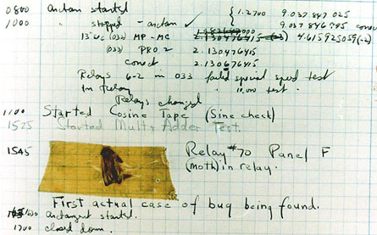
History of the Software Bug
The Middle English word bugge is a term used for a monster
1878 – Thomas Edison said “…bugs – as such little faults and difficulties are called…”
1931 – Baffle Ball advertised as “free of bugs”
1945 – Harvard team working on Mark II finds moth in one of the relays
Notes:
Software bugs cost the U.S. $80 billion/year
Half that cost is felt by end users and the rest is on developers and vendors

Slide 3
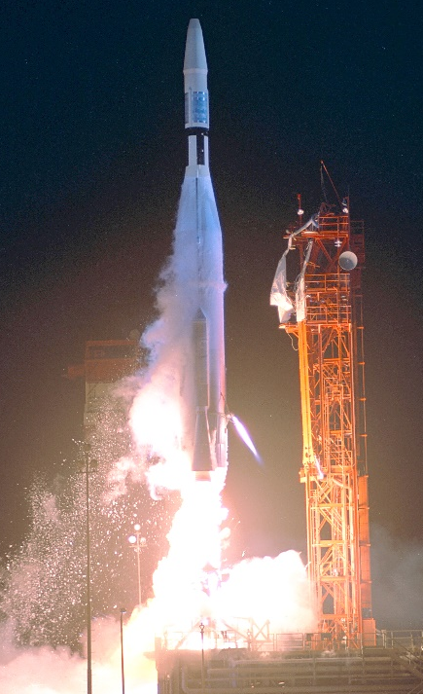
Mariner 1 (1962)
Five minutes into Mariner 1’s launch it began to yaw off course
The rocket was headed straight towards North Atlantic shipping lanes
The range safety officer ordered a self-destruct
Engineer wrote '‾' and the programmer typed –
Cost: $145.1 million
Notes:
Engineer left a superscript bar over a radius symbol which, in rocket science, signifies a smoothing function
Without the smoothing function, minor variations in speed would trigger the boosters to overcorrect
The equivalence would be driving and yanking the steering wheel side-to-side to avoid every minor obstacle

Slide 4
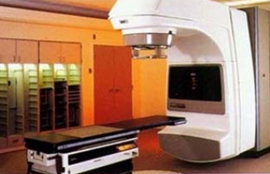
Therac-25 Medical Accelerator Disaster (1985)
Therac-25 was a radiation therapy machine used in the treatment of cancer patients
Two modes: precision electron beam and a megavolt X-ray mode which required shielding, filters, and an ion chamber to keep beams safely on target
Some patients exposed to megavolt X-rays on accident
Caused by race condition in the software
Cost: 6 radiation overdoses
Notes:
If the operators changed the mode of the device too quickly, a race condition occurred
Two sets of instructions were sent, and the first one to arrive set the mode.
In six documented cases, this meant that megavolt X-rays were sent, unfiltered and unshielded, towards patients requiring direct electron therapy
Some patients screamed in pain and tried to run from the room. All of them suffered radiation poisoning,
Several of them died directly from radiation poisoning, the rest died from complications of that and their cancer
This didn’t happen in previous models of the Therac since there were hardware limitations in place. The Therac-25 did not have those limitations, but the software from earlier models was used without testing it

Slide 5
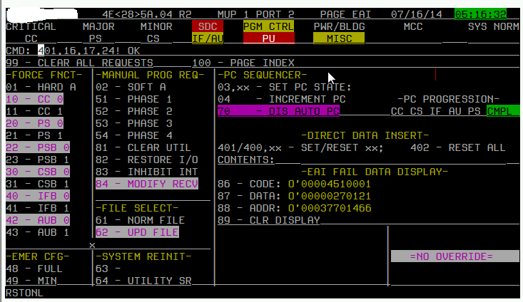
AT&T Long-Distance Bug (1990)
January 15, 1990 – 60,000 long distance calls failed
All 144 4ESS long-distance switches were stuck in reboot loops
AT&T thought it was being hacked for nine hours
If one switch gets congested, sends “do not disturb” message to the next switch
The second switch reboots itself to prepare for extra traffic
Process sped up and led to loop
Cost: $108.76 million
Notes:
3 months before the crash, AT&T tweaked the code to speed up the load handling process but it was too quick
The first server overload sent two messages; the second message hit the switch as it was rebooting
This caused the switch to believe it had an internal fault in its CCS7 logic and rebooted itself
Since it detected a problem, it put out a “do not disturb” message to the next switch
This issue cascaded through all 144 switches until the fix went through
AT&T was “kind” enough to discount long-distance rates by a third on Valentine’s Day to make amends with customers

Slide 6
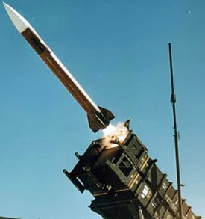
Patriot Missile Accident (1991)
Patriot missiles used to protect against Iraqi-fired SCUD missiles during the first Persian Gulf War
42 Patriot missiles were successfully launched during that conflict, but one was unsuccessful
The failed missile never launched over the U.S. base in Dhahran, Saudi Arabia
Caused by clock time being off
Cost: 28 lives
Notes:
The Patriot missile would get within a few feet of the SCUD missile and explode over 1,000 pellets
The trajectory calculations revolved around the timing of radar pulses
Due to the high speed of missiles they had to be converted to floating-point figures
As this ran on, the clock time would desynchronize
This issue was known, and the workaround was to reboot the system every so often
This particular Patriot missile system had been running for about 100 hours and the clock was off by a third of a second
In that time a SCUD missile travels a quarter mile so the Patriot missile was completely off

Slide 7
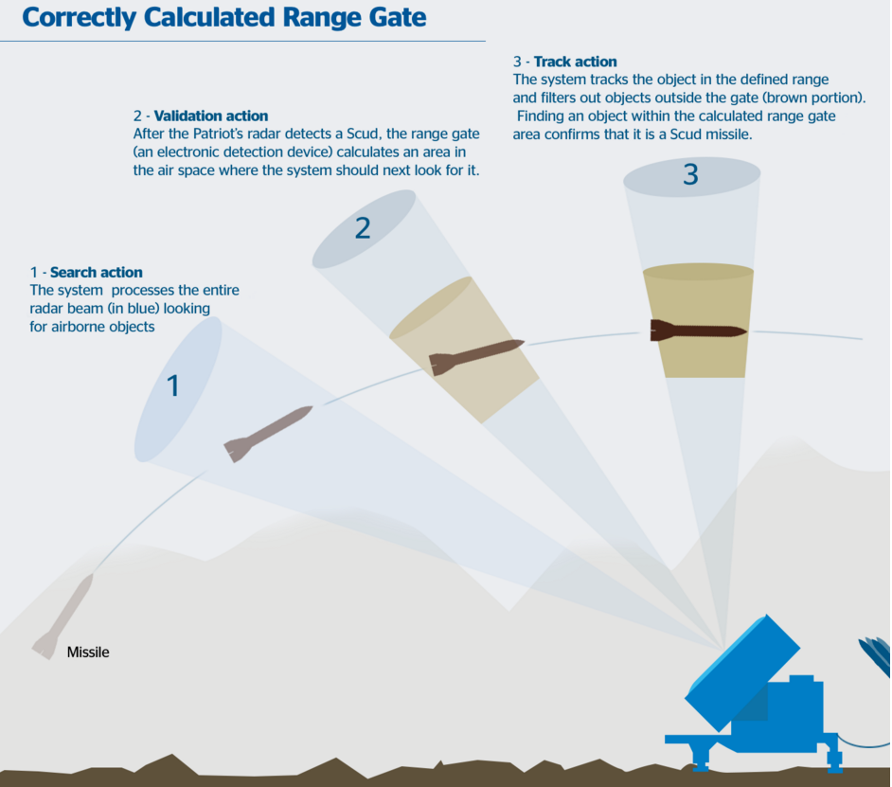

Slide 8
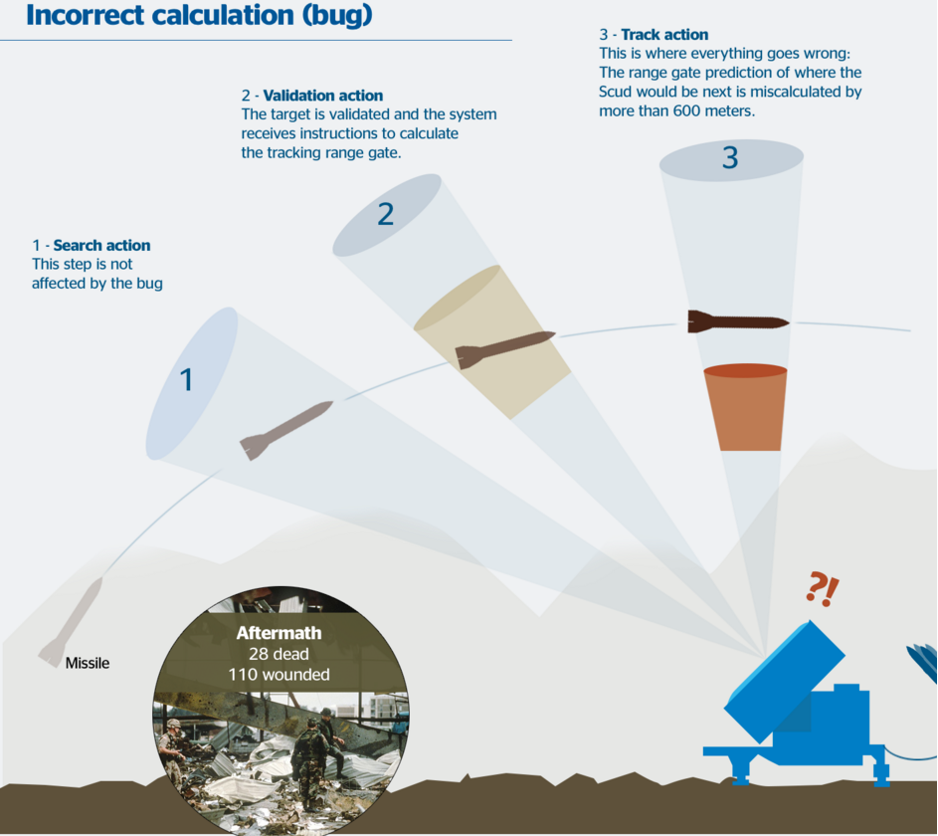

Slide 9
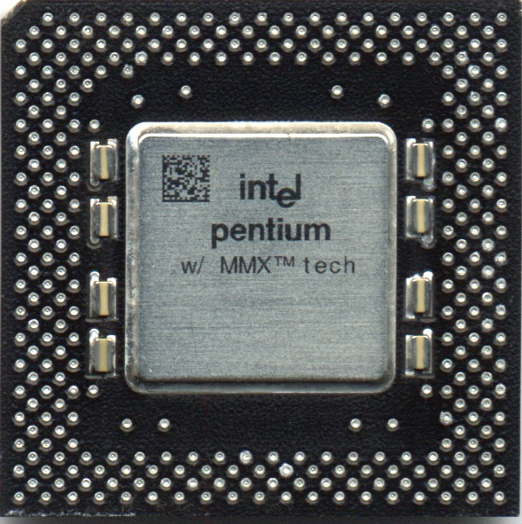
Pentium Floating-Point Miscalculations (1994)
Intel launched Pentium processor in March 1993
Intel implemented lookup tables for floating points
Some table entries did not make it onto the chip
1-in-9 billion chance of a miscalculation
Intel discovered bug in June 1994
In October 1994, math professor Thomas Nicely discovered miscalculations with floating points
Cost: $759.4 million
Notes:
Lookup tables tripled speed of floating-point calculations over the shift-and-subtract algorithm
1,066 table entries, but 5of them didn’t make it
Intel discovered the issue first, but there was nothing they could do so kept quiet assuming no one would need ultra-high precision of floating point calculations
Math professor Thomas Nicely did need that level of precision. He was upset with Intel’s response and went to the media
Intel spent half a billion dollars replacing faulty processors
Pentium chips should have calculated 1,066 – 5 = -$475 million

Slide 10
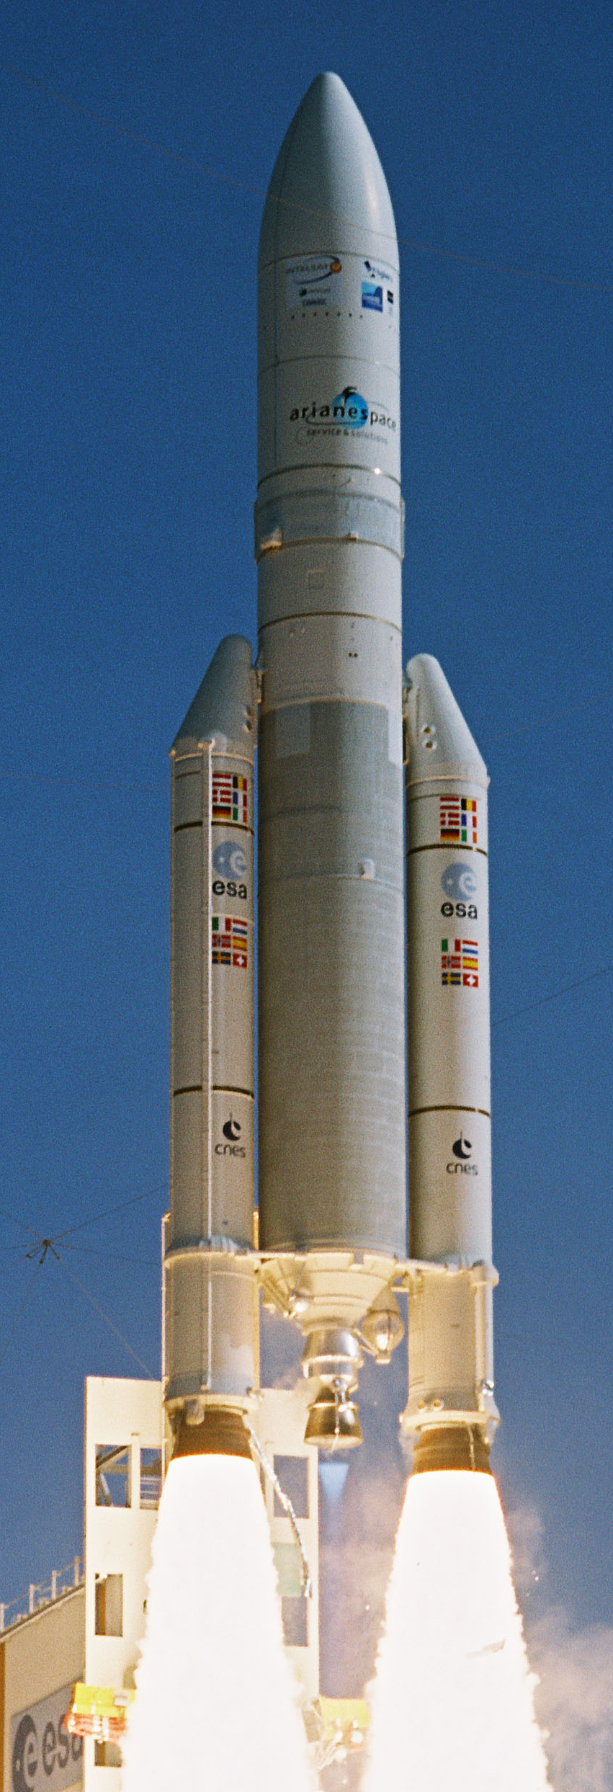
Ariane-5 (1996)
European Space Agency (ESA) launched this satellite
Thirty seconds into liftoff it lost guidance and altitude information
Veered completely off-course and automatically self-destructed in 40 seconds
Caused by inertial reference system converting a 64-bit float to a 16-bit signed integer which produced an overflow error
Cost: $254 million
Notes:
The single variable was used to determine horizontal bias.
The overflow error crashed the whole flight system
There was a handler built for these errors but it was disabled

Slide 11

Mars Climate Orbiter (1998)
Robotic space probe manufactured by Lockheed Martin and launched by NASA
Goals were to study the Martian climate, atmosphere, and surface changes
Miscalculated trajectory and burned up in Mars’s atmosphere
Error due to one team using the Imperial system and the other team using the metric system
Cost: $327.6 million
Notes:
Team from Lockheed Martin had ground software measuring thrusters in pounds-force seconds
Team from NASA were expecting the metric Newton-seconds
This resulted in the thrusters being 4.5 times more powerful than they should have been

Slide 12
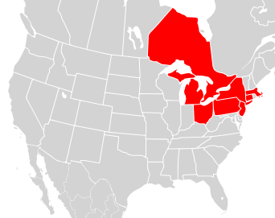
Northeast Blackout (2003)
50 million people lost power during a heatwave
Some power restored earliest after seven hours
Most did not get power restored until two days later
Caused by race condition in the control software
Cost: $10 billion and 11 lives
Notes:
Entire state of New York lost power
No subways, 911 service, stoplights, gas pumps, generators ran out, people had to walk in the heat
The bug was in the alarm system in the control room of FirstEnergy in Ohio.
A lack of alarm left operaters unaware of the need to redistribute power after overloaded transmission lines hit trees

Slide 13
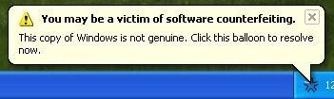
Windows Genuine (Dis)Advantage (2006)
There was no real advantage to Windows Genuine Advantage
Microsoft released it to reduce software piracy
An individual on the WGA team accidentally pushed faulty software to the WGA servers
For 19 hours, thousands of Windows customers were falsely flagged for using “pirated” Windows
XP users had an annoying popup but Vista users had some Windows features disabled entirely
Cost: Bad PR
Notes:
Disabled Vista features included the Aero theme and even total RAM usage
The real bug was that it didn’t disable Vista entirely
WGA was later discontinued in 2009 after reports that piracy was even more rampant than before it

Slide 14
Knight Capital (2012)
Firm that specializes in executing trades for retail brokers
Their software ran a trading algorithm that focused on a stock’s bid and ask price
During a test-run the software flipped the bid and asking price
This resulted in instantaneous losses up to 40 trades per second which went on for 45 minutes
Cost: $440 million
Notes:
The bid price is what the user would like to pay the stockholder to buy their shares
The ask price is what the stockholder would pay to buy the same shares from the user

